Slide 1
Lesson objective
PBiS focus
Respect (hands up)
Achieve (on task)
Need whiteboards and calculators.
Title: Fractions and percentages
Aim:
Move between fraction and percentages when solving problems.
Plan:
Review converting FDP
Review percent of amount
Working with fractions and percent

Slide 2
Fractions
Decimals
Numerator ÷ Denominator
÷ 100
x 100
Number over 100, simplify
Percentages
Draw diagram for notes
FDP millionnaire.ppt

Slide 3
Whiteboards
Decimal
0.16
?
0.76
?
Percent
55%
21%
Fraction

Slide 4
We do
Convert percent to decimal
Change OF to multiplication
Multiply decimal to amount
43% of 560L
95% of 350m
32.6% of $76.40

Slide 5
Whiteboards
Convert percent to decimal
Change OF to multiplication
Multiply decimal to amount
25% of 560L
21.9% of 87m
76% of $70
4% of 58cm
2.5% of 320mm

Slide 6
Math test
Garry score 34 of out of 72 on his math test.
What is this as a percentage?
If Sally got 87% on the same test, what did she score?

Slide 7
Quick practice
Page 185
Questions 1 - 13

Slide 8
Challenge questions
When we earn money, a percentage of that is given to the government as Tax. Tax goes towards several public services, like hospitals, schools roads, fire fighters and etc.
The tax percent depends on how much you earn.

Slide 9
Dream job?
Write down how much you’re going to earn.

Slide 10
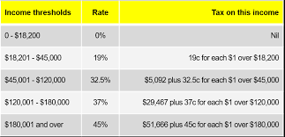
Calculate how much you would pay in tax

